Slide 1
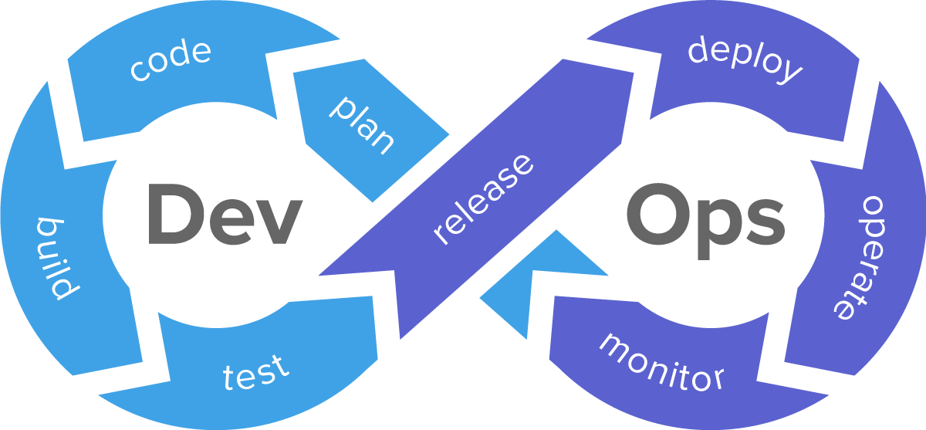
- Shariq Nawaz
Devops CICD – Chef

Slide 2


Slide 3
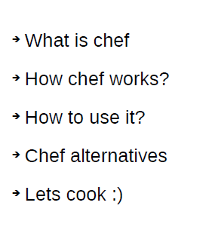

Slide 4
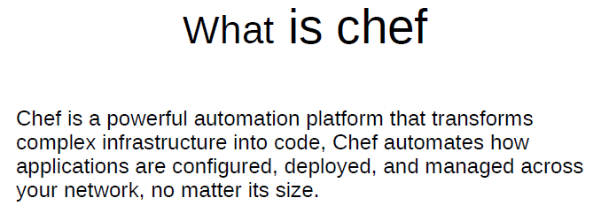

Slide 5
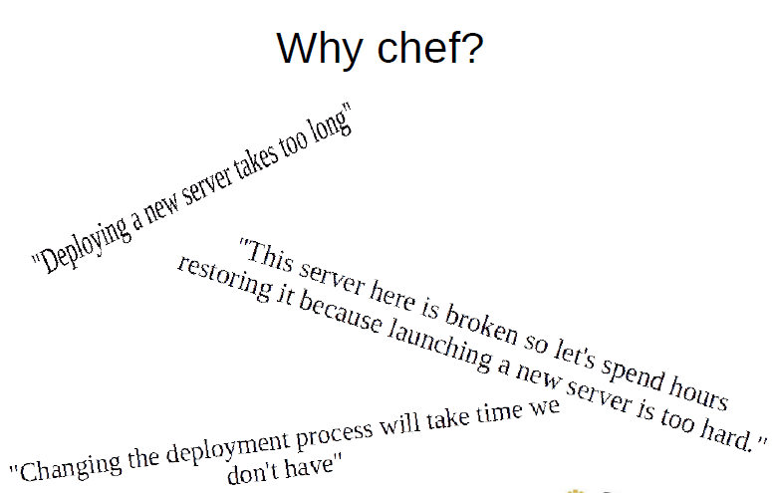

Slide 6


Slide 7
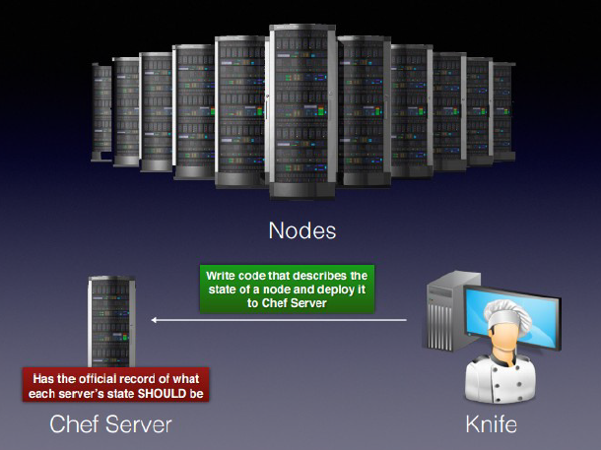

Slide 8
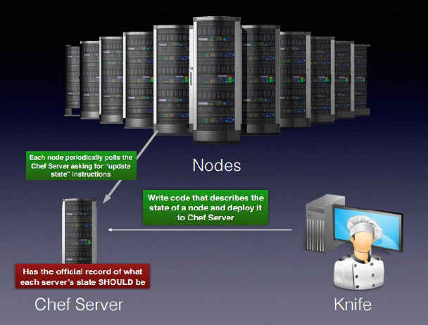

Slide 9
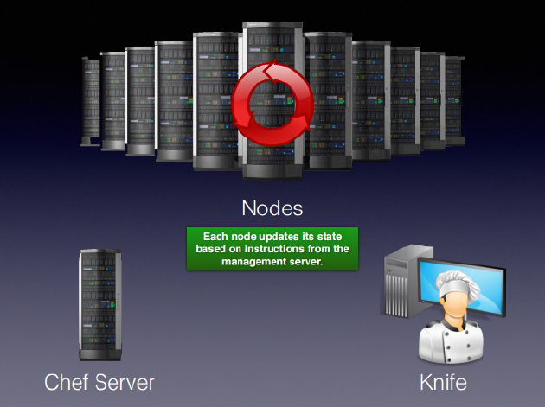

Slide 10
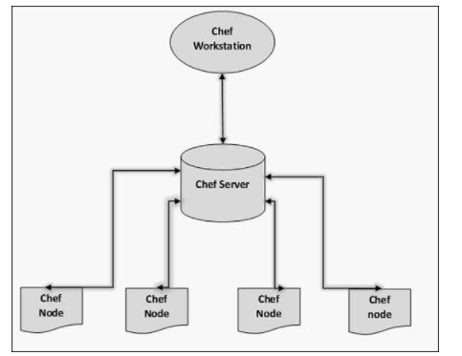
Chef works on a three-tier client server model wherein the working units such as cookbooks are developed on the Chef workstation.
From the command line utilities such as knife, they are uploaded to the Chef server and all the nodes which are present in the architecture are registered with the Chef server.

Slide 11
Chef Workstation
This is the location where all the configurations are developed.
Chef workstation is installed on the local machine
Chef Server
This works as a centralized working unit of Chef setup, where all the configuration files are uploaded post development.
There are different kinds of Chef server, some are hosted Chef server whereas some are built-in premise.
Chef Nodes
They are the actual machines which are going to be managed by the Chef server.
All the nodes can have different kinds of setup as per requirement.
Chef client is the key component of all the nodes, which helps in setting up the communication between the Chef server and Chef node.
The other components of Chef node is Ohai, which helps in getting the current state of any node at a given point of time.

Slide 12
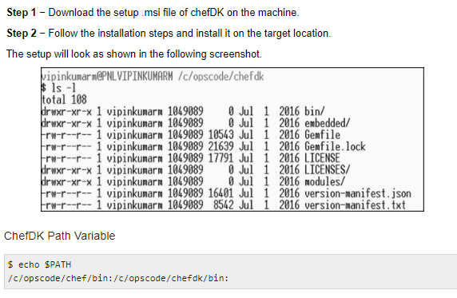
Chef Workstation Setup
On Windows Machine

Slide 13
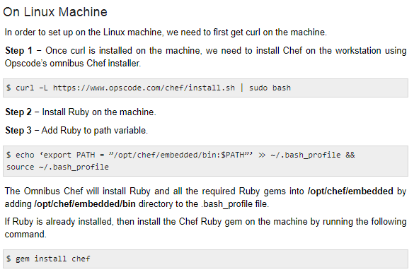
On Linux Machine

Slide 14
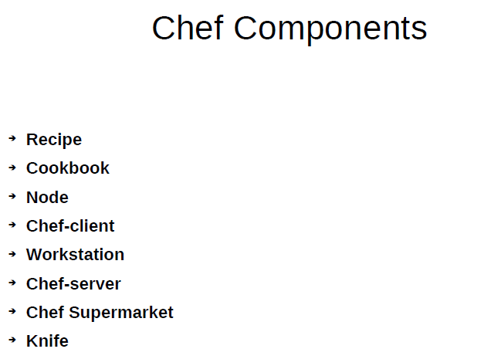

Slide 15
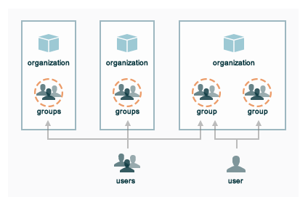
Chef Terminology
Organization - The Chef server uses role-based access control (RBAC) to restrict access to objects—nodes, environments, roles, data bags, cookbooks, and so on.
This ensures that only authorized user and/or chef-client requests to the Chef server are allowed.
Access to objects on the Chef server is fine-grained, allowing access to be defined by object type, object, group, user, and organization.
The Chef server uses organizations, groups, and users to define role-based access control
https://docs-archive.chef.io/release/server_12-4/server_orgs.html

Slide 16
Cookbook : A cookbook is the fundamental unit of configuration and policy distribution. A cookbook defines a scenario and contains everything that is required to support that scenario:
Recipes that specify the resources to use and the order in which they are to be applied
Attribute values
File distributions
Templates
Extensions to Chef, such as custom resources and libraries
Recipes: A recipe is the most fundamental configuration element within the organization. A recipe:
Must define everything that is required to configure part of a system
Must be stored in a cookbook
May be included in another recipe
May use the results of a search query and read the contents of a data bag (including an encrypted data bag)
May have a dependency on one (or more) recipes
Attributes: An attribute can be defined in a cookbook (or a recipe) and then used to override the default settings on a node. When a cookbook is loaded during a Chef Infra Client run, these attributes are compared to the attributes that are already present on the node. For each cookbook, attributes in the default.rb file are loaded first.

Slide 17
Files: A file distribution is a specific type of resource that tells a cookbook how to distribute files, including by node, by platform, or by file version.
Libraries: A library allows the use of arbitrary Ruby code in a cookbook, either as a way to extend the Chef Infra Client language or to implement a new class.
Custom Resources: A custom resource is an abstract approach for defining a set of actions and (for each action) a set of properties and validation parameters. Templates: A template is a file written in markup language that uses Ruby statements to solve complex configuration scenarios.

Slide 18
Chef Client Setup
This is one of the key components of Chef node, which retrieves the cookbooks from the Chef server and executes them on the node. It is also known as the Chef provisioner.
We will use Vagrant to manage VM. Vagrant can also be configured with the provisioner such as Shell script, Chef and Puppet to get VM into a desired state.
In our case, we will use Vagrant to manage VMs using VirtualBox and Chef client as a provisioner.
Step 1 − Download and install VirtualBox from https://www.virtualbox.org/wiki/downlod
Step 2 − Download and install Vagrant at http://downloads.vagrantup.com
Step 3 − Install Vagrant Omnibus plugin to enable Vagrant to install Chef client on the VM.
Vagrant.configure("2") do |config|
config.vm.box = "opscode-ubuntu-12.04"
config.vm.box_url = https://opscode-vm-bento.s3.amazonaws.com/
vagrant/opscode_ubuntu-12.04_provisionerless.box
config.omnibus.chef_version = :latest
config.vm.provision :chef_client do |chef|
chef.provisioning_path = "/etc/chef"
chef.chef_server_url = "https://api.opscode.com/
organizations/<YOUR_ORG>"
chef.validation_key_path = "/.chef/<YOUR_ORG>-validator.pem"
chef.validation_client_name = "<YOUR_ORG>-validator"
chef.node_name = "server"
end
end

Slide 19
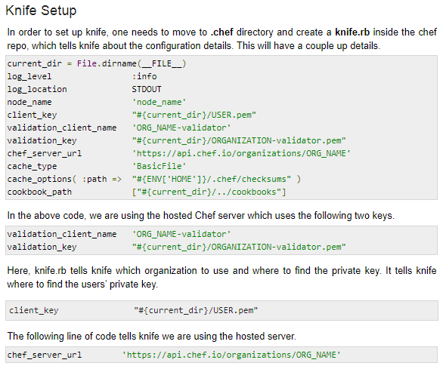
Knife Setup
Knife is Chef’s command-line tool to interact with the Chef server. One uses it for uploading cookbooks and managing other aspects of Chef. It helps in managing.
Chef nodes
Cookbook
Recipe
Environments
Cloud Resources
Cloud Provisioning
Installation on Chef
client on Chef nodes

Slide 20
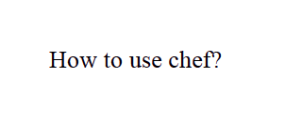

Slide 21
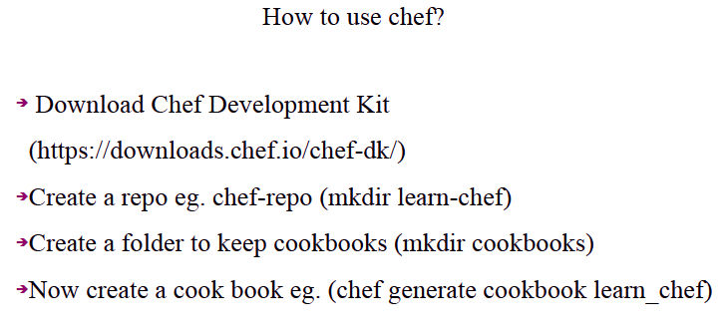

Slide 22
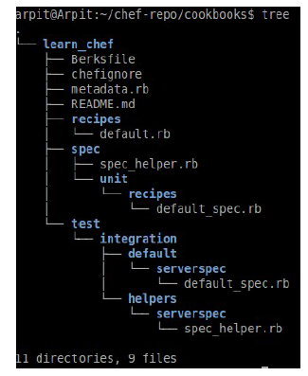

Slide 23
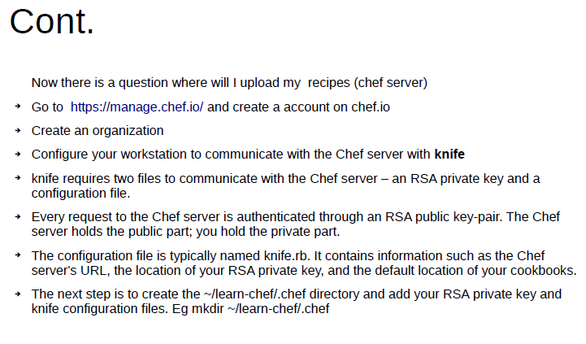

Slide 24
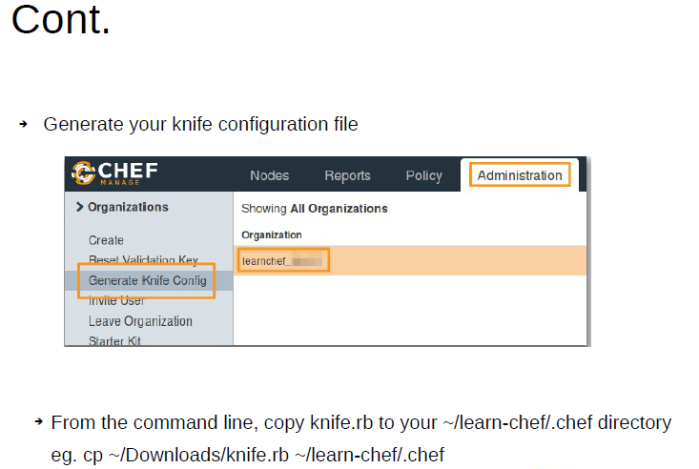

Slide 25
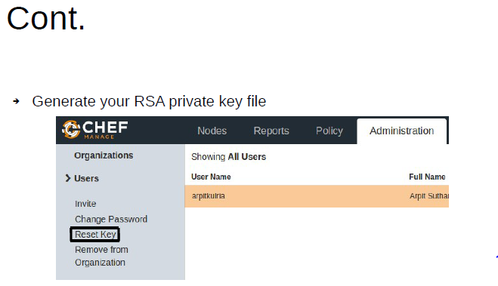

Slide 26
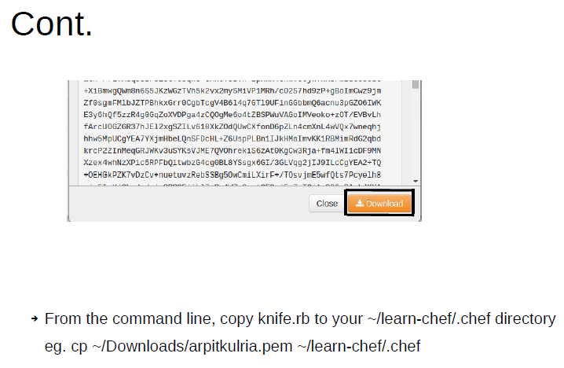

Slide 27
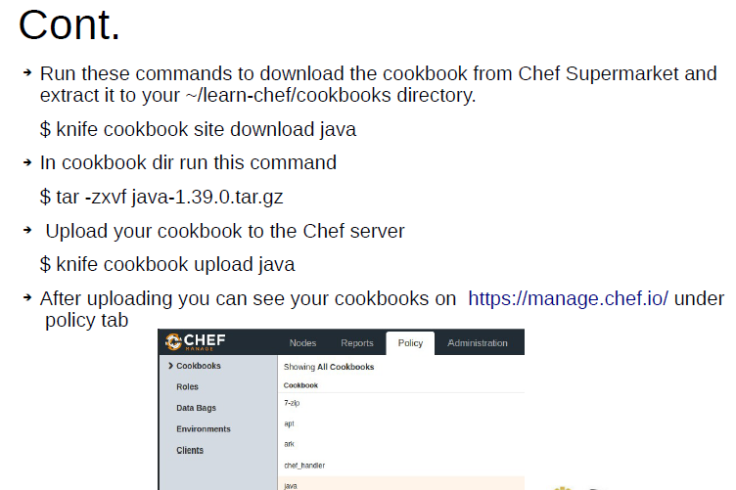

Slide 28
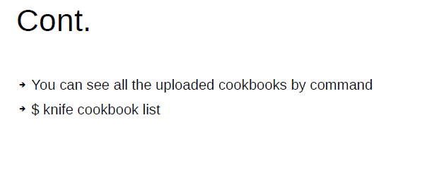

Slide 29
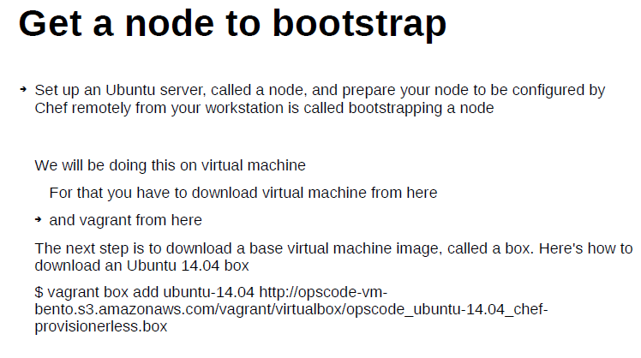

Slide 30
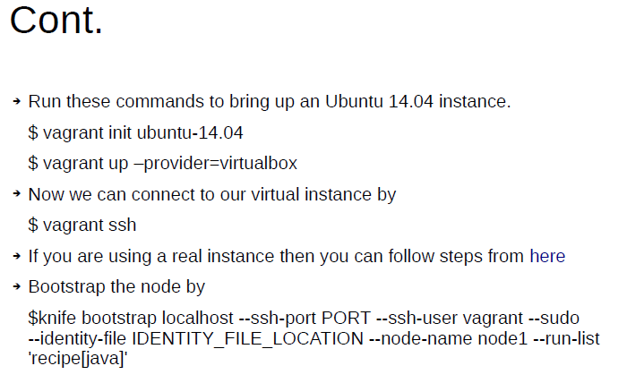

Slide 31
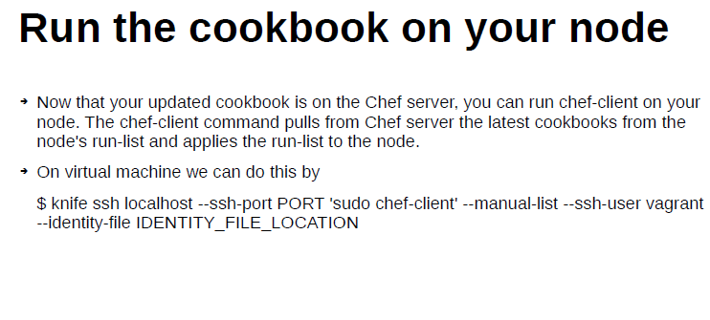

Slide 32
Thank you

